Slide 1
End-to-end ML Project House price prediction
Fernando Carazo, PhD
Master de Innovación Tecnológica - 2021

Slide 2
Stages of a machine learning problem
Define the problem: What do you intend to predict? What data is available? o What data is necessary to obtain?
Success metric: define an appropriate way to quantify how good the results are.
1. Exploratory analysis
Make your own hypotheses and plot your data!!
2. Data preprocessing
Preprocess the data: apply the necessary transformations so that the data can be interpreted by the selected machine learning algorithm.
3. Model
Fit a first model capable of exceeding minimum results. For example, in classification problems, the minimum to overcome is the percentage of the majority class (the mode). In a regression model, the mean of the response variable.
Gradually improve the model by incorporating-creating new variables or optimizing the hyperparameters.
Evaluate the ability of the final model with the test set to have an estimate of the ability of the model when predicting new observations.

Slide 3
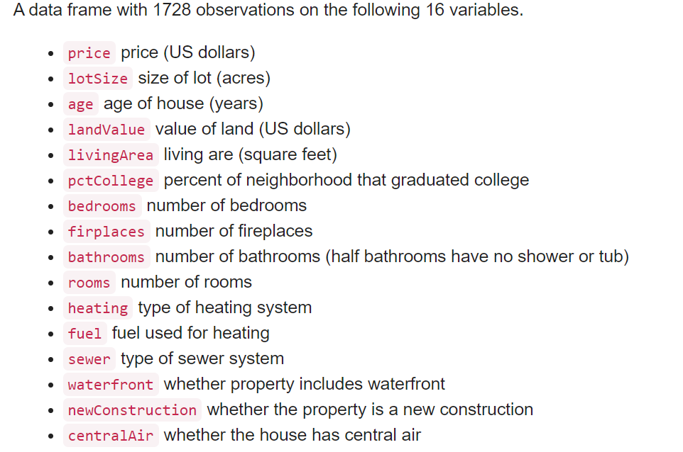

House price prediction – frame the problem
Define the problem: What do you intend to predict? What data is available? o What data is necessary to obtain?
-> Build a model to predict the price of a house based on the following features: hypotheses?

Slide 4
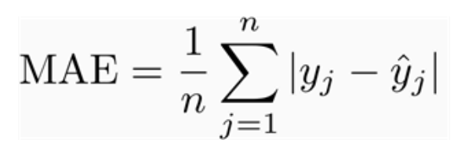
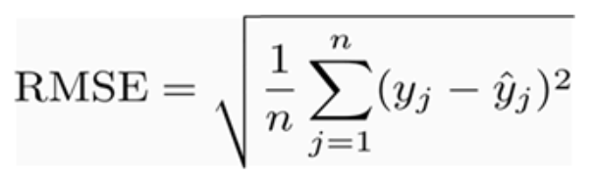
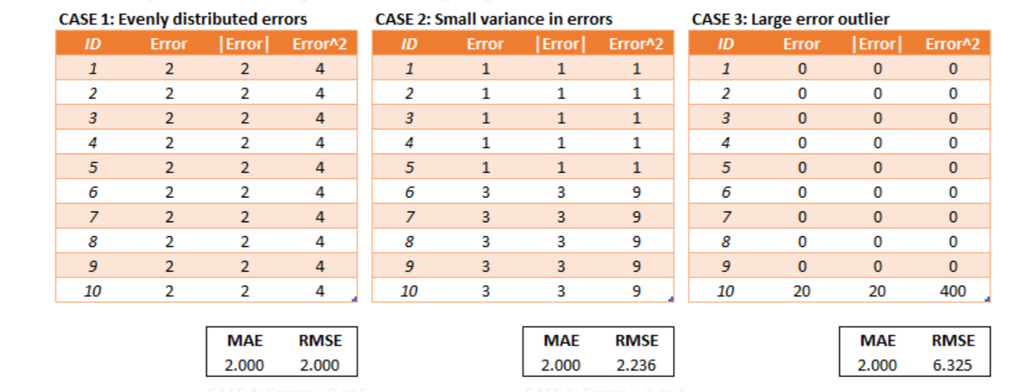
Start from the end: what’s a good solution
Select a performance measure

Slide 5
1. Exploratory analysis
Type of each column
Number of observations, missing values and outliers
Response variable → power transformations
Numerical variables
Numerical variables correlation
Qualitative variables

Slide 6
2. Data preprocessing
Train and test division → evaluation in CV
Imputation of missing values
Exclusion of variables with variance close to zero
Power transformations
Standardization and scaling of numerical variables
Binarization of qualitative variables
Pipeline and ColumnTransformer

Slide 7
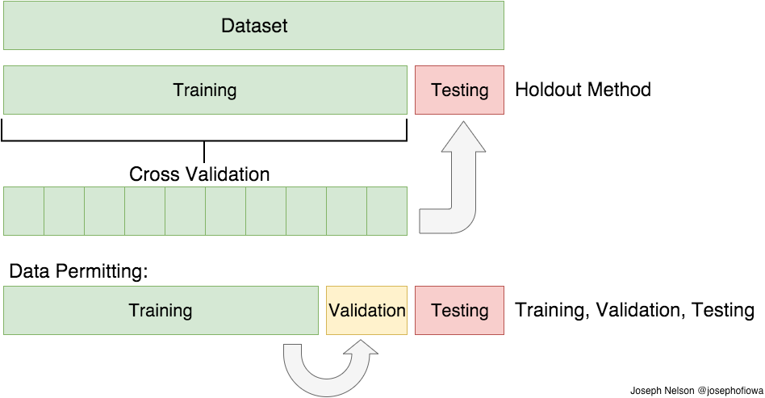
Train and test division → evaluation in CV
Prepare the strategy to evaluate the model: separate the observations into a training set, a validation set (or cross-validation) and a test set. It is very important to ensure that no information from the test set participates in the model training process.
10-fold crossvalidation

Slide 8
Train and test division → evaluation in CV
X
10-fold crossvalidation

Slide 9
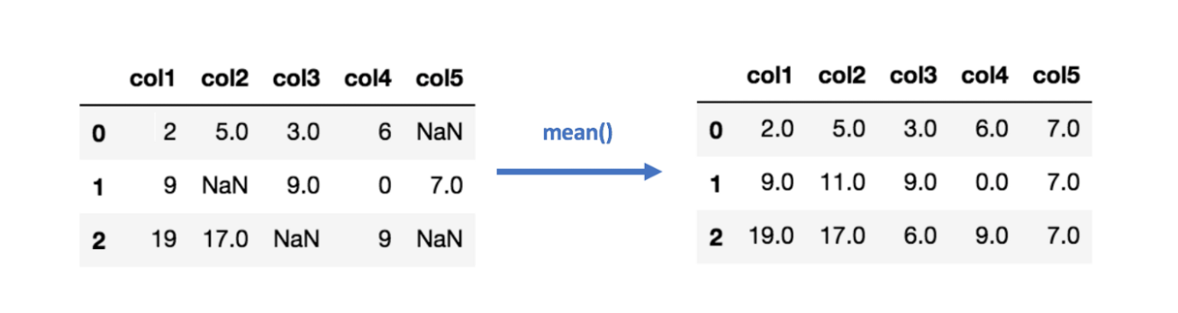
Imputation of missing values
Ideas??

Slide 10
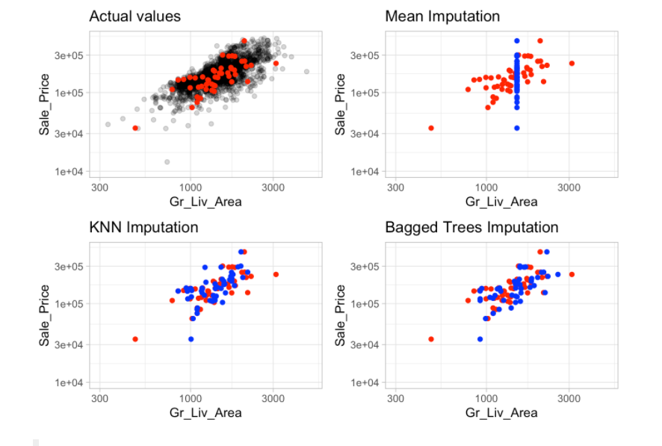
Imputation of missing values
Do nothing
Impute mean, median or mode
Find similar entrances

Slide 11
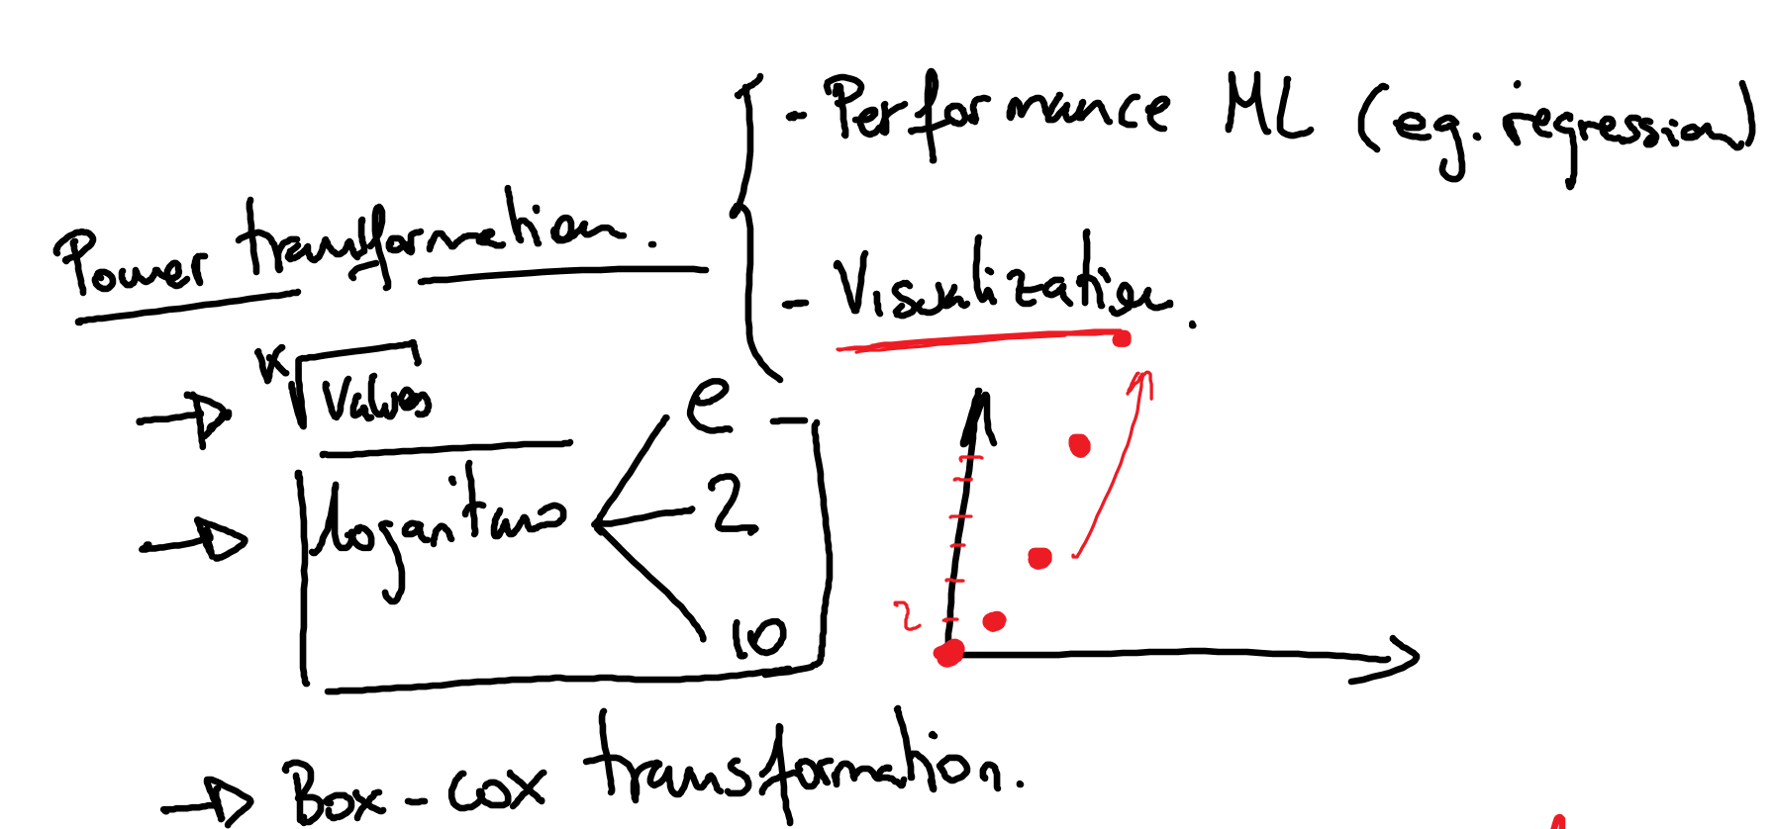
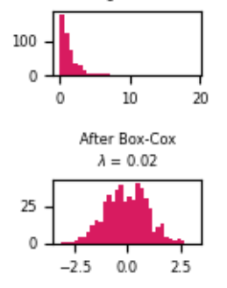
Power transformations

Slide 12
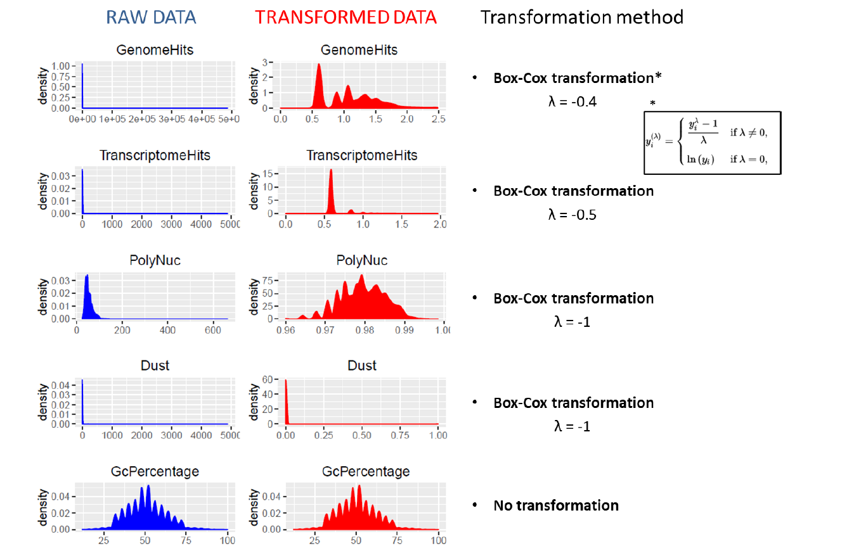
Power transformations

Slide 13
3. Model
Create a (simple) model
Training
Validation
Prediction
Test error
Hyperparameters (tuning)

Slide 14
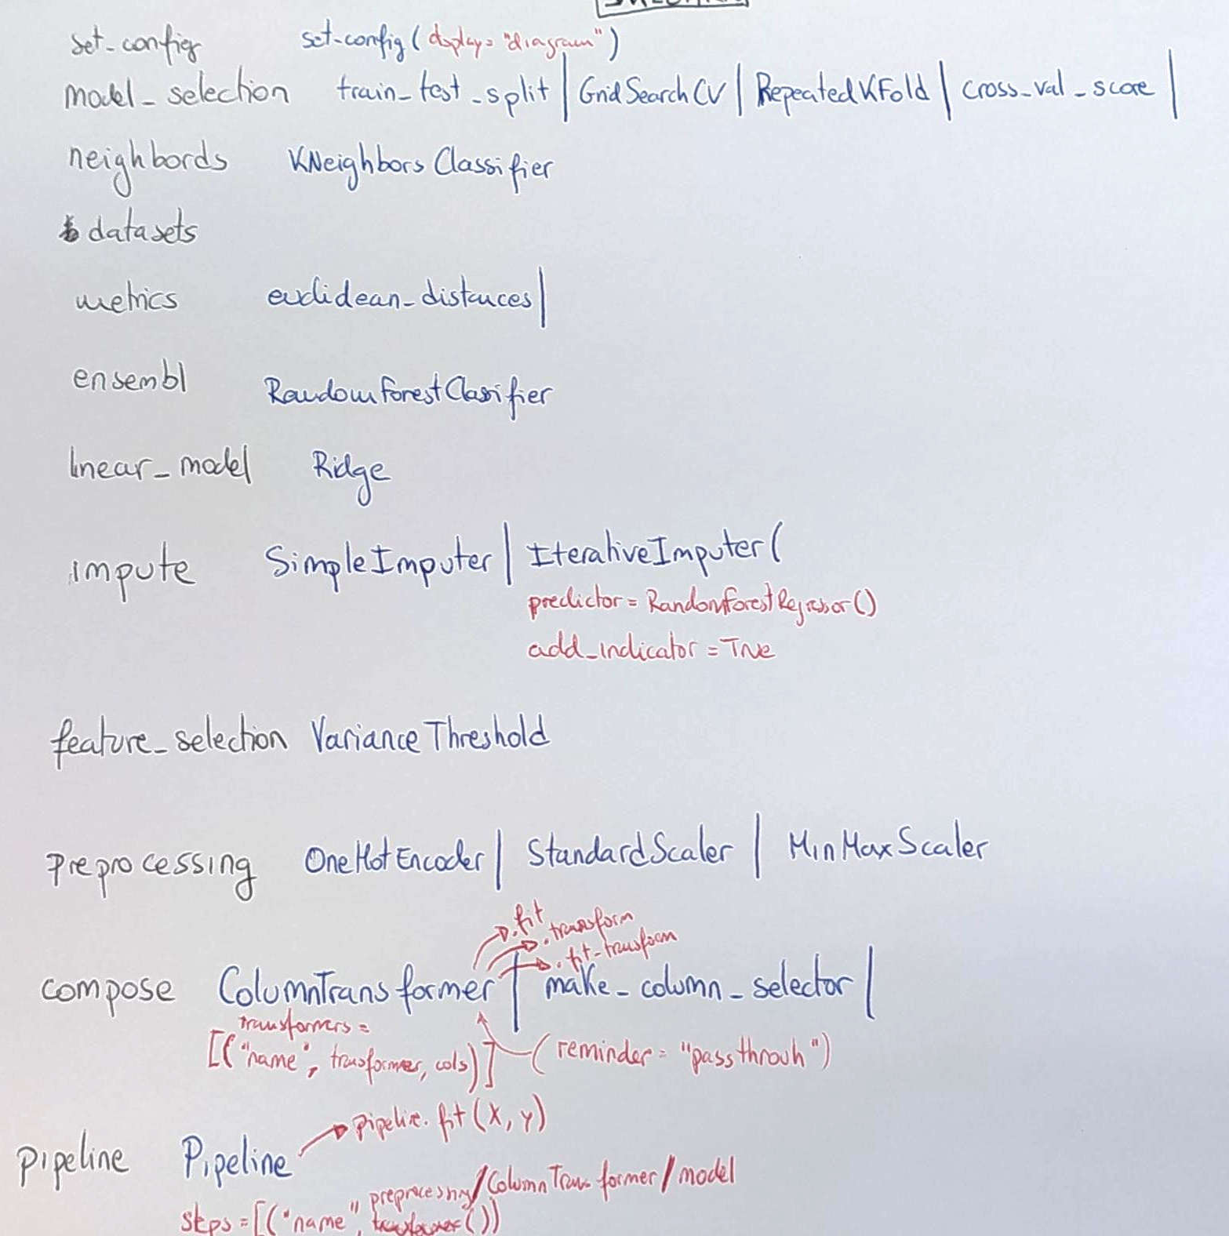

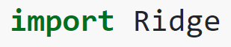
Sklearn. [..]
https://scikit-learn.org/stable/modules/classes.html

Slide 15
End-to-end ML Project House price prediction
Fernando Carazo, PhD
Master de Innovación Tecnológica - 2021

